Slide 1
Distributed Systems Design COMP 6231
﻿Fault Tolerance
Lecture 10
Essam Mansour

Slide 2
Today…
Today’s Session:
Fault-Tolerance
Announcements:
The 2nd midterm exam is on Wed, April 07 at 11:45 am.
The demo of the projects is on Mon, April 12
from 10.30 am to 12 pm and
from 12.15 pm to 2.30 pm.

Slide 3

Distributed Systems
Scalability
Consistency
Fault Tolerance & Availability
Notes:
Over the past decade – many if not all applications use cloud as their backend infrastructure. The applications need to be scalable..

Slide 4










Scalability
Consider Amazon’s data
Too many items to store in a single machine
Data can be too large to be stored in a single server
Notes:
The data produced by the applications can be too large

Slide 5

Scalability
Partition data eg. based on category
Data can be too large to be stored in a single server
Shard or Partition the data
Store smaller chunks in each server

Slide 6





Consistency
Superman wants to transfer $100 to Wonderwoman
Transactions read and write data
Data should be updated in a consistent manner
The database must maintain consistency
$m=
$m-$100
$n=
$n+$100
Notes:
All or nothing

Slide 7
Fault-tolerance and Availability
Commodity servers crash frequently
Data should be replicated for fault-tolerance and high availability
I hope my bank balance info is fault tolerant!

Slide 8


Fault-Tolerance
Systems can be designed in a way that can automatically recover from partial failures
Fault-tolerance is the property that enables a system to continue operating properly even if a failure takes place during operation
For example, TCP is designed to allow reliable two-way communications in packet-switched networks, even in the presence of communication links that are imperfect or overloaded
Tire punctured.
Car stopped.
Tire punctured. It got masked and car continued.

Slide 9
What is a Failure?
A failure is a deviation from a specified behavior
E.g., Pressing brake pedal does not stop car ➔ brake failure (could be catastrophic!)
E.g., Read of a disk sector does not return content ➔ disk failure (not necessarily catastrophic)
Many failures are due to incorrect specified behavior
This typically happens when the designer misses addressing a scenario that makes the system perform incorrectly
It is especially true in complex systems with many subtle interactions

Slide 10
Failure Characteristics
Failures can be characterized as either transient or persistent
Transient Failures:
Also referred to as “soft failures” or “Heisenbugs”
Occur temporarily then disappear
Manifested only in a very unlikely combination of circumstances
Typically go away upon rolling back and/or retrying/rebooting
E.g., Frozen keyboard or window, race conditions and deadlocks, etc.

Slide 11
Failure Characteristics
Failures can be characterized as either transient or persistent
Persistent Failures:
Persist until explicitly repaired
Retrying does not help
E.g., Burnt-out chips, software bugs, crashed disks, broken Ethernet cable, etc.
Durations of failures and repairs are random variables
Means of distributions are Mean Time To Fail (MTTF) and Mean Time To Repair (MTTR)
In-Service
Out-of-Service
MTTF
MTTR

Slide 12
Fault Tolerance Basic Concepts
Being fault tolerant is strongly related to what are called dependable systems
Dependability implies the following:
Availability
Reliability
Safety
Maintainability

Slide 13
Availability vs. Reliability
There is a distinction between availability and reliability
Availability refers to the probability that a system is operating correctly at any given moment
Availability = MTTF/(MTTF+MTTR)
Reliability measures how long a system can operate without a breakdown
A highly-available (HA) system is one that will most likely be working at a given instant in time
A highly-reliable system is one that will most likely continue to work without interruption during a relatively long period of time

Slide 14
Availability vs. Reliability
Examples:
A system that goes down for 1ms every hour has an availability of over 99.9999%, but is highly unreliable
A system that never crashes but is shut down for two weeks every August has high reliability, but only 96% availability
System Type | Availability (%) | Downtime in a Year
Conventional Workstation | 99 | 3.6 Days
High-Available (HA) System | 99.9 | 8.4 Hours
Fault-Resilient System | 99.99 | 1 Hour
Fault-Tolerant System | 99.999 | 5 Minutes

Slide 15
Failure Types
Type of Failure | Description
Crash Failure | A server halts, but was working correctly until it stopped
Omission Failure Receive Omission Send Omission | A server fails to respond to incoming requests A server fails to receive incoming messages A server fails to send messages
Timing Failure | A server’s response lies outside the specified time interval
Response Failure Value Failure State Transition Failure | A server’s response is incorrect The value of the response is wrong The server deviates from the correct flow of control
Byzantine Failure | A server may produce arbitrary responses at arbitrary times
Type of Failure | Description
Crash Failure | A server halts, but was working correctly until it stopped
Omission Failure Receive Omission Send Omission | A server fails to respond to incoming requests A server fails to receive incoming messages A server fails to send messages
Timing Failure | A server’s response lies outside the specified time interval
Response Failure Value Failure State Transition Failure | A server’s response is incorrect The value of the response is wrong The server deviates from the correct flow of control
Byzantine Failure | A server may produce arbitrary responses at arbitrary times
Type of Failure | Description
Crash Failure | A server halts, but was working correctly until it stopped
Omission Failure Receive Omission Send Omission | A server fails to respond to incoming requests A server fails to receive incoming messages A server fails to send messages
Timing Failure | A server’s response lies outside the specified time interval
Response Failure Value Failure State Transition Failure | A server’s response is incorrect The value of the response is wrong The server deviates from the correct flow of control
Byzantine Failure | A server may produce arbitrary responses at arbitrary times
Type of Failure | Description
Crash Failure | A server halts, but was working correctly until it stopped
Omission Failure Receive Omission Send Omission | A server fails to respond to incoming requests A server fails to receive incoming messages A server fails to send messages
Timing Failure | A server’s response lies outside the specified time interval
Response Failure Value Failure State Transition Failure | A server’s response is incorrect The value of the response is wrong The server deviates from the correct flow of control
Byzantine Failure | A server may produce arbitrary responses at arbitrary times
Type of Failure | Description
Crash Failure | A server halts, but was working correctly until it stopped
Omission Failure Receive Omission Send Omission | A server fails to respond to incoming requests A server fails to receive incoming messages A server fails to send messages
Timing Failure | A server’s response lies outside the specified time interval
Response Failure Value Failure State Transition Failure | A server’s response is incorrect The value of the response is wrong The server deviates from the correct flow of control
Byzantine Failure | A server may produce arbitrary responses at arbitrary times
Type of Failure | Description
Crash Failure | A server halts, but was working correctly until it stopped
Omission Failure Receive Omission Send Omission | A server fails to respond to incoming requests A server fails to receive incoming messages A server fails to send messages
Timing Failure | A server’s response lies outside the specified time interval
Response Failure Value Failure State Transition Failure | A server’s response is incorrect The value of the response is wrong The server deviates from the correct flow of control
Byzantine Failure | A server may produce arbitrary responses at arbitrary times
Type of Failure | Description
Crash Failure | A server halts, but was working correctly until it stopped
Omission Failure Receive Omission Send Omission | A server fails to respond to incoming requests A server fails to receive incoming messages A server fails to send messages
Timing Failure | A server’s response lies outside the specified time interval
Response Failure Value Failure State Transition Failure | A server’s response is incorrect The value of the response is wrong The server deviates from the correct flow of control
Byzantine Failure | A server may produce arbitrary responses at arbitrary times
Type of Failure | Description
Crash Failure | A server halts, but was working correctly until it stopped
Omission Failure Receive Omission Send Omission | A server fails to respond to incoming requests A server fails to receive incoming messages A server fails to send messages
Timing Failure | A server’s response lies outside the specified time interval
Response Failure Value Failure State Transition Failure | A server’s response is incorrect The value of the response is wrong The server deviates from the correct flow of control
Byzantine Failure | A server may produce arbitrary responses at arbitrary times
Type of Failure | Description
Crash Failure | A server halts, but was working correctly until it stopped
Omission Failure Receive Omission Send Omission | A server fails to respond to incoming requests A server fails to receive incoming messages A server fails to send messages
Timing Failure | A server’s response lies outside the specified time interval
Response Failure Value Failure State Transition Failure | A server’s response is incorrect The value of the response is wrong The server deviates from the correct flow of control
Byzantine Failure | A server may produce arbitrary responses at arbitrary times

Slide 16
Failure Types
Type of Failure | Description
Crash Failure | A server halts, but was working correctly until it stopped
Omission Failure Receive Omission Send Omission | A server fails to respond to incoming requests A server fails to receive incoming messages A server fails to send messages
Timing Failure | A server’s response lies outside the specified time interval
Response Failure Value Failure State Transition Failure | A server’s response is incorrect The value of the response is wrong The server deviates from the correct flow of control
Byzantine Failure | A server may produce arbitrary responses at arbitrary times
Type of Failure | Description
Crash Failure | A server halts, but was working correctly until it stopped
Omission Failure Receive Omission Send Omission | A server fails to respond to incoming requests A server fails to receive incoming messages A server fails to send messages
Timing Failure | A server’s response lies outside the specified time interval
Response Failure Value Failure State Transition Failure | A server’s response is incorrect The value of the response is wrong The server deviates from the correct flow of control
Arbitrary Failure | A server may produce arbitrary responses at arbitrary times
Type of Failure | Description
Crash Failure | A server halts, but was working correctly until it stopped
Omission Failure Receive Omission Send Omission | A server fails to respond to incoming requests A server fails to receive incoming messages A server fails to send messages
Timing Failure | A server’s response lies outside the specified time interval
Response Failure Value Failure State Transition Failure | A server’s response is incorrect The value of the response is wrong The server deviates from the correct flow of control
Byzantine Failure | A server may produce arbitrary responses at arbitrary times
Type of Failure | Description
Crash Failure | A server halts, but was working correctly until it stopped
Omission Failure Receive Omission Send Omission | A server fails to respond to incoming requests A server fails to receive incoming messages A server fails to send messages
Timing Failure | A server’s response lies outside the specified time interval
Response Failure Value Failure State Transition Failure | A server’s response is incorrect The value of the response is wrong The server deviates from the correct flow of control
Byzantine Failure | A server may produce arbitrary responses at arbitrary times
Type of Failure | Description
Crash Failure | A server halts, but was working correctly until it stopped
Omission Failure Receive Omission Send Omission | A server fails to respond to incoming requests A server fails to receive incoming messages A server fails to send messages
Timing Failure | A server’s response lies outside the specified time interval
Response Failure Value Failure State Transition Failure | A server’s response is incorrect The value of the response is wrong The server deviates from the correct flow of control
Byzantine Failure | A server may produce arbitrary responses at arbitrary times
Type of Failure | Description
Crash Failure | A server halts, but was working correctly until it stopped
Omission Failure Receive Omission Send Omission | A server fails to respond to incoming requests A server fails to receive incoming messages A server fails to send messages
Timing Failure | A server’s response lies outside the specified time interval
Response Failure Value Failure State Transition Failure | A server’s response is incorrect The value of the response is wrong The server deviates from the correct flow of control
Byzantine Failure | A server may produce arbitrary responses at arbitrary times
Type of Failure | Description
Crash Failure | A server halts, but was working correctly until it stopped
Omission Failure Receive Omission Send Omission | A server fails to respond to incoming requests A server fails to receive incoming messages A server fails to send messages
Timing Failure | A server’s response lies outside the specified time interval
Response Failure Value Failure State Transition Failure | A server’s response is incorrect The value of the response is wrong The server deviates from the correct flow of control
Byzantine Failure | A server may produce arbitrary responses at arbitrary times
Type of Failure | Description
Crash Failure | A server halts, but was working correctly until it stopped
Omission Failure Receive Omission Send Omission | A server fails to respond to incoming requests A server fails to receive incoming messages A server fails to send messages
Timing Failure | A server’s response lies outside the specified time interval
Response Failure Value Failure State Transition Failure | A server’s response is incorrect The value of the response is wrong The server deviates from the correct flow of control
Byzantine Failure | A server may produce arbitrary responses at arbitrary times
Type of Failure | Description
Crash Failure | A server halts, but was working correctly until it stopped
Omission Failure Receive Omission Send Omission | A server fails to respond to incoming requests A server fails to receive incoming messages A server fails to send messages
Timing Failure | A server’s response lies outside the specified time interval
Response Failure Value Failure State Transition Failure | A server’s response is incorrect The value of the response is wrong The server deviates from the correct flow of control
Byzantine Failure | A server may produce arbitrary responses at arbitrary times
Known generally as Fail-Stop or Fail-Fast Failures
Known generally as Fail-Silent Failures
Known generally as Arbitrary or Byzantine Failures

Slide 17
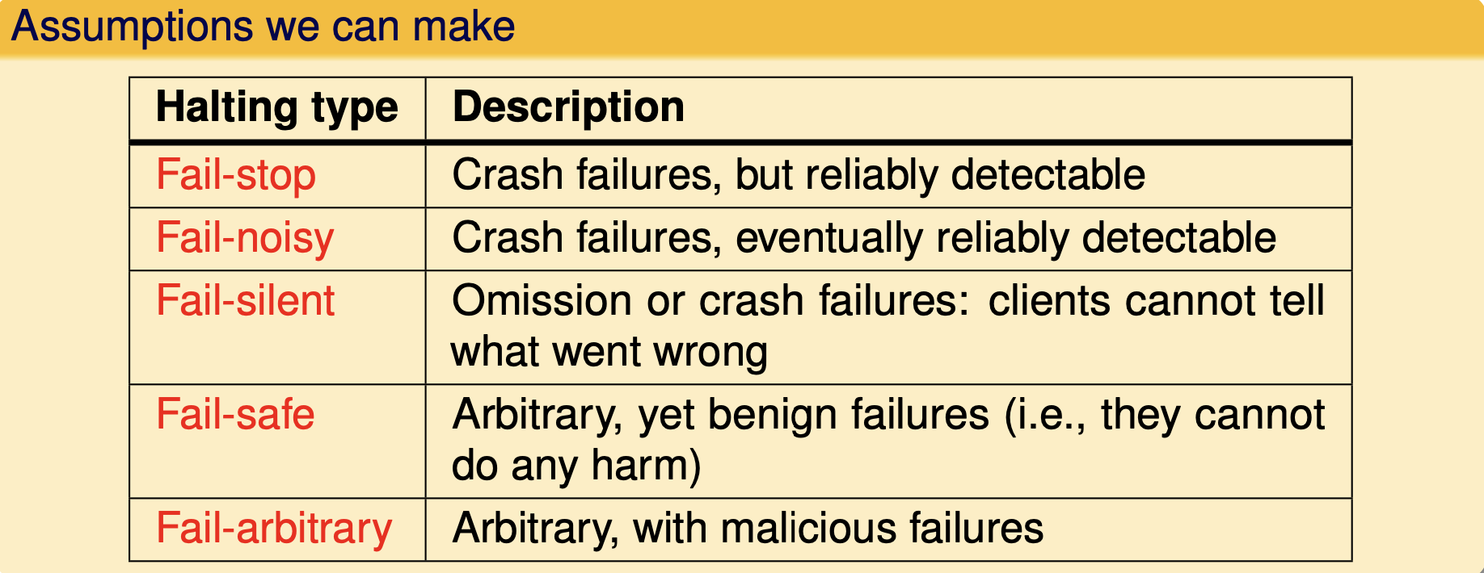
Halting failures

Slide 18
Masking Failures
The key technique for masking failures is to use redundancy
Usually, extra bits are added to allow recovery from garbled bits
Information
Usually, extra equipment are added to allow tolerating failed hardware components
Usually, extra processes are added to allow tolerating failed processes
Redundancy
Software
Hardware
Time
Usually, an action is performed, and then, if required, it is performed again

Slide 19
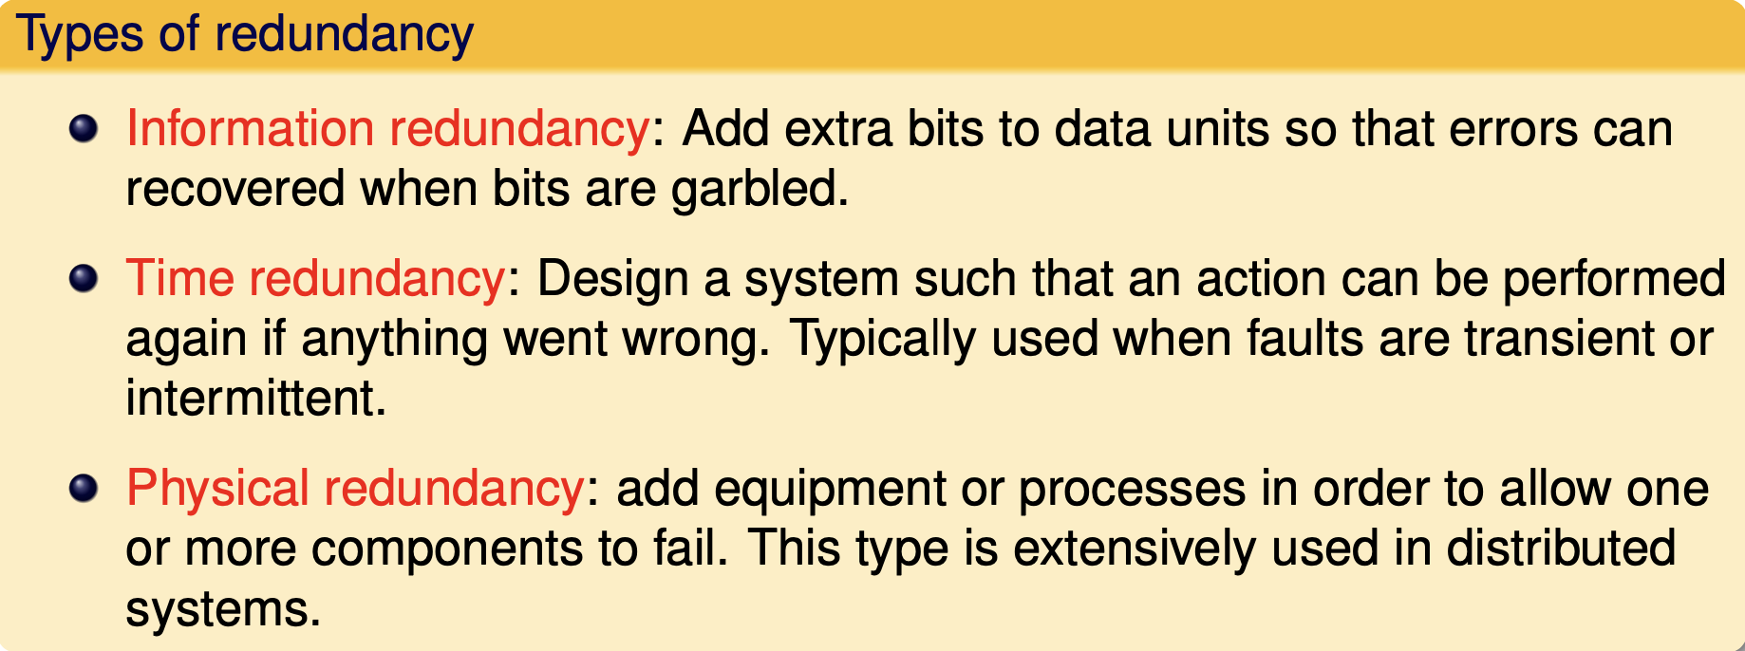
Redundancy for failure masking

Slide 20
Detecting Failures
But, failures need to be detected before they can be masked
A detection subsystem (especially, for a fail-stop or fail-silent failure):
Can usually be done as a side-effect of regularly exchanging information with servers
Should ideally be able to distinguish between network and server failures
A process, P, that cannot reach a server can check with other processes on whether they can reach the server
If at least one other process indicates that it can reach the server, P can presume that it is a network failure (assuming all processes are non-malicious/non-faulty)

Slide 21
Example 1: Speculative Execution in Hadoop
A MapReduce job is dominated by the slowest task
MapReduce attempts to locate slow tasks (or stragglers) and run replicated (or speculative) tasks that will optimistically commit before corresponding stragglers
In general, this strategy is known as task resiliency or task replication (as opposed to data replication)
In Hadoop it is called speculative execution
Only one copy of a straggler is allowed to be speculated
Whichever task (among the two tasks) commits first, its results are exploited, and the other task is killed

Slide 22
But, How to Detect Stragglers?
Hadoop monitors the progresses of all tasks and assigns each task a progress score between 0 and 1
A task is marked as a straggler if its progress score (PS) < (average – 0.2) after running at least 1 minute
T1
Not a straggler
PS= 2/3
T2
A straggler
PS= 1/12
Time

Slide 23
Example 2: Atomic Multicasting
Atomic multicasting requires satisfying two conditions:
A message should be delivered to either all or none of the processes (or replica sites)
This property is known as atomicity
All messages should be delivered in the same order to all processes (or replica sites)
This property is known as consistent ordering
The atomicity property entails reliable multicasting since it guarantees that ALL (or none) of the processes will receive the multicast message

Slide 24
Message Ordering
As discussed before, there are typically three types of message orderings:
Sequential (or FIFO) Ordering
Messages sent from the same process are delivered in the same order as they were sent at every receiving process
Causal Ordering
If message m₁ causally precedes message m₂, m₁ is delivered before m₂ at every receiving process
Total Ordering
Messages are delivered in the same order at every receiving process

Slide 25


Protocols
Fault-tolerance and Availability
Consensus and Replication Protocols
E.g., Paxos
Scalability and Consistency
Atomic Commit Protocols
E.g., 2 Phase Commit

Slide 26
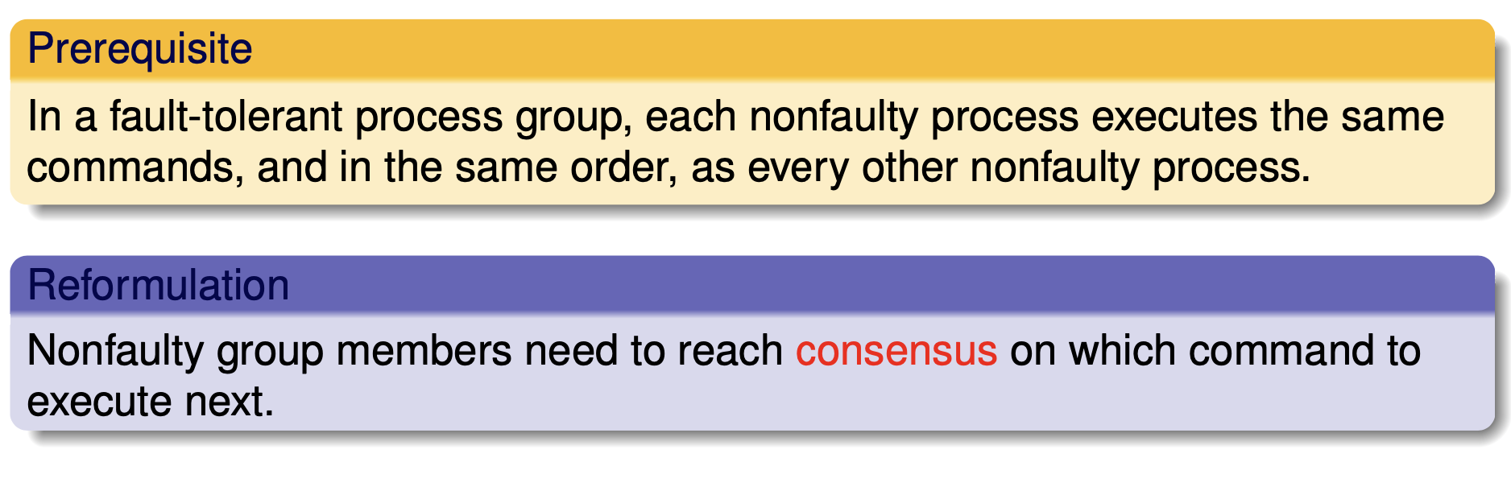
Realistic consensus: Paxos
Paxos is a family of protocols for solving consensus in a network of unreliable or fallible processors.
Consensus is the process of agreeing on one result among a group of participants.
This problem becomes difficult when the participants or their communications may experience failures.

Slide 27
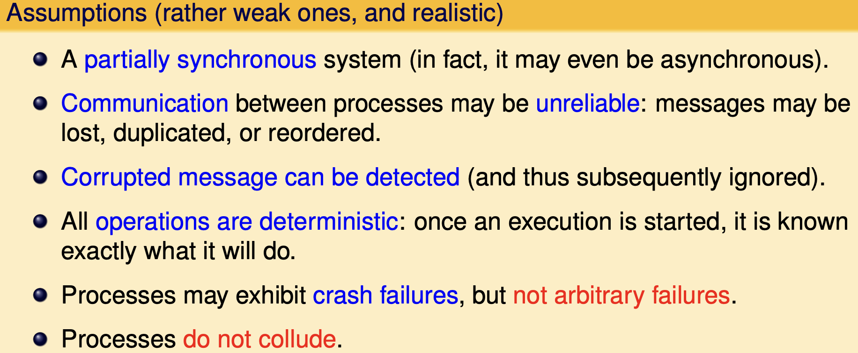
Realistic consensus: Paxos

Slide 28
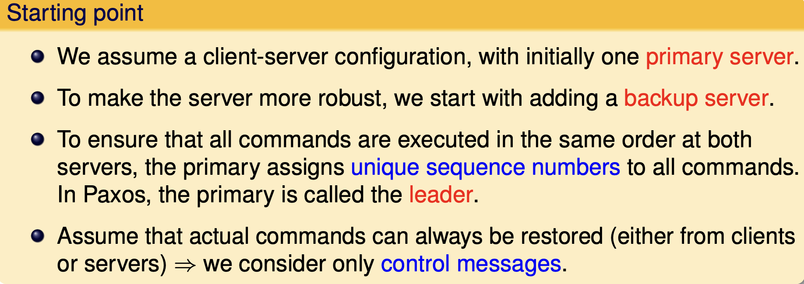
Paxos essentials

Slide 29
Distributed Atomic Transactions
Atomic multicasting is an example of a general problem, known as distributed atomic transactions
Given a transaction with multiple actions
Either all or none of the actions are committed
If all actions are committed, they will be committed in the same order at all replica sites
A popular distributed atomic transaction protocol is known as the two-phase commit protocol (2PC), which involves:
One coordinator
Multiple participants

Slide 30
Failures in a distributed system
Consistency requires agreement among multiple servers
Is transaction X committed?
Have all servers applied update X to a replica?
Achieving agreement w/ failures is hard
Impossible to distinguish host vs. network failures
This class:
all-or-nothing atomicity in distributed systems

Slide 31

Example
Transfer $1000
From A:$3000
To B:$2000
client
Bank A
Bank B
Clients want all-or-nothing transactions
Transfer either happens or not at all

Slide 32
Strawman solution
Transfer $1000
From A:$3000
To B:$2000
Transaction
coordinator
client
Bank A
Bank B

Slide 33
Strawman solution
client
transaction
coordinator
bank A
bank B
start
A=A-1000
done
B=B+1000
What can go wrong?
A does not have enough money
B’s account no longer exists
B has crashed
Coordinator crashes

Slide 34
Reasoning about correctness
TC, A, B each has a notion of committing
Correctness:
If one commits, no one aborts
If one aborts, no one commits
Performance:
If no failures, A and B can commit, then commit
If failures happen, find out outcome soon

Slide 35
Correctness first
client
transaction
coordinator
bank A
bank B
start
prepare
prepare
rA
rB
outcome
result
outcome
If rA==yes && rB==yes
outcome = “commit”
else
outcome = “abort”
B commits upon
receiving “commit”

Slide 36
Performance Issues
What about timeouts?
TC times out waiting for A’s response
A times out waiting for TC’s outcome message
What about reboots?
How does a participant clean up?

Slide 37
Handling timeout on A/B
TC times out waiting for A (or B)’s “yes/no” response
Can TC unilaterally decide to commit?
Can TC unilaterally decide to abort?

Slide 38
Handling timeout on TC
If B responded with “no” …
Can it unilaterally abort?
If B responded with “yes” …
Can it unilaterally abort?
Can it unilaterally commit?

Slide 39
Possible termination protocol
Execute termination protocol if B times out on TC and has voted “yes”
B sends “status” message to A
If A has received “commit”/”abort” from TC …
If A has not responded to TC, …
If A has responded with “no”, …
If A has responded with “yes”, …
Resolves most failure cases except
sometimes when TC fails

Slide 40
Two-Phase Commit Protocol
2PC is comprised of the following two phases, each involving two steps:
Phase I: Voting Phase
Step 1 | The coordinator sends a VOTE_REQUEST message to all participants.
Step 2 | When a participant receives a VOTE_REQUEST message, it returns either a VOTE_COMMIT message to the coordinator indicating that it is prepared to locally commit its part of the transaction, or otherwise a VOTE_ABORT message.
Phase I: Voting Phase
Step 1 | The coordinator sends a VOTE_REQUEST message to all participants.
Step 2 | When a participant receives a VOTE_REQUEST message, it returns either a VOTE_COMMIT message to the coordinator telling the coordinator that it is prepared to locally commit its part of the transaction, or otherwise a VOTE_ABORT message
Phase I: Voting Phase
Step 1 | The coordinator sends a VOTE_REQUEST message to all participants.
Step 2 | When a participant receives a VOTE_REQUEST message, it returns either a VOTE_COMMIT message to the coordinator telling the coordinator that it is prepared to locally commit its part of the transaction, or otherwise a VOTE_ABORT message

Slide 41
Two-Phase Commit Protocol
Phase II: Decision Phase
Step 1 | The coordinator collects all votes from the participants. If all participants have voted to commit the transaction, then so will the coordinator. In that case, it sends a GLOBAL_COMMIT message to all participants. However, if one participant had voted to abort the transaction, the coordinator will also decide to abort the transaction and multicast a GLOBAL_ABORT message.
Step 2 | Each participant that voted for a commit waits for the final reaction by the coordinator. If a participant receives a GLOBAL_COMMIT message, it locally commits the transaction. If a participant receives a GLOBAL_ABORT message, , it locally aborts the transaction.

Slide 42
2PC Finite State Machines
Note: The terms above and below the line indicate what have been received and sent, respectively
Vote-request
Vote-abort
Commit
Vote-request
INIT
INIT
Vote-request
Vote-commit
WAIT
READY
Vote-abort
Global-abort
Vote-commit
Global-commit
Global-abort
ACK
Global-commit
ACK
ABORT
COMMIT
ABORT
COMMIT
The finite state machine of the
COORDINATOR in 2PC
The finite state machine of a
PARTICIPANT in 2PC
Notes:
The coordinator as well as the participants have states in which they block waiting for incoming messages. Consequently, the protocol can easily fail when a process crashes for other processes may be indefinitely waiting for a message from that process. For this reason, a timeout mechanism is used.

Slide 43
Summary: two-phase commit
All nodes that decide reach the same decision
No commit unless everyone says "yes".
No failures and all "yes", then commit.
If failures, then repair, wait long enough for recovery, then some decision.

Slide 44
Centralized 2PC
P
P
P
P
C
C
C
P
P
P
P
ready?
yes/no
commit/abort?
commited/aborted
Phase 1
Phase 2

Slide 45
2PC Protocol Actions
Coordinator
Participant
INITIAL
INITIAL
PREPARE
write
begin_commit
in log
write abort
in log
No
Ready to
Commit?
VOTE-ABORT
Yes
WAIT
VOTE-COMMIT
write ready
in log
Any No?
Yes
write abort
in log
GLOBAL-ABORT
READY
No
VOTE-COMMIT
write commit
in log
Abort
Type of
msg
ACK
Commit
COMMIT
ABORT
write abort
in log
ACK
write commit
in log
write
end_of_transaction
in log
ABORT
COMMIT

Slide 46
Problem With 2PC
Blocking
Ready implies that the participant waits for the coordinator
If coordinator fails, site is blocked until recovery
Blocking reduces availability
Independent recovery is not possible
However, it is known that:
Independent recovery protocols exist only for single site failures; no independent recovery protocol exists which is resilient to multiple-site failures.
So we search for these protocols – 3PC

Slide 47
Three-Phase Commit
3PC is non-blocking.
A commit protocols is non-blocking iff
it is synchronous within one state transition, and
its state transition diagram contains
no state which is “adjacent” to both a commit and an abort state, and
no non-committable state which is “adjacent” to a commit state
Adjacent: possible to go from one stat to another with a single state transition
Committable: all sites have voted to commit a transaction
e.g.: COMMIT state

Slide 48
State Transitions in 3PC
Coordinator
Participants
INITIAL
INITIAL
Commit command
Prepare
Prepare
Prepare
Vote-commit
Vote-abort
WAIT
READY
Vote-abort
Vote-commit
Global-abort
Prepared-to-commit
Global-abort
Prepare-to-commit
Ack
Ready-to-commit
ABORT
PRE-
COMMIT
ABORT
PRE-
COMMIT
Ready-to-commit
Global commit
Global commit
Ack
COMMIT
COMMIT

Slide 49
Communication Structure in 3PC
P
P
P
P
P
P
C
C
C
C
P
P
P
P
P
P
pre-commit/
ready?
yes/no
pre-abort?
yes/no
commit/abort
ack
Phase 1
Phase 2
Phase 3

